Slide 1



Assignment 3
EXPLORATORY DATA ANALYSIS
https://intip.in/EDAIUP2022
Teaching Assistant :
Bramandika (06211940000059)
Maura Putri Defa (06211940000139)
Sepuluh Nopember Institute of Technology, Surabaya - Indonesia

Slide 2
Look for dataset yourself (from Kaggle, UCI, classic dataset, etc.).
Define the type and the scale measurement of each columns from the data (example gender : type=qualitative,scale=nominal)
tell the step of how to clean your dataset, if there’s none then just tell there’s none
minimum requirement in the pdf is using three method and 1 plot
Do a presentation on our next meeting (week 6) max 5 minutes each student
File that you have to submit are :
1. PPT (but make it as pdf)
2. R syntax
Link submission :
https://intip.in/Assignment3EDAIUP
Deadline:
March 18th, 2022 at 23:59 WIB

Slide 3
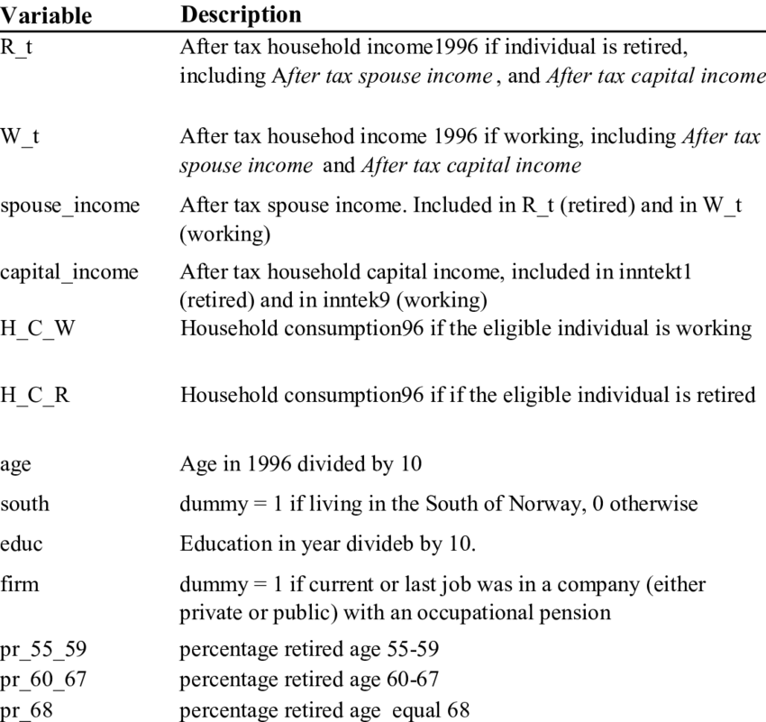
Dataset Description
Where you get the dataset?
How many rows are in the dataset?
How many variables?
What are the variables in the dataset?
For example, you can say that the dataset consists of 150 records with 13 variables with the description as shown in the table here.
‹#›

